Slide 1

Airline Reservation System

Slide 2
Presented by –
Pias Miah (19201103054)
Mrityunjoy Biswas (19201103064)
Asha Akter (19201103077)
Supervised by –
Shovon Roy
Lecture, Department of CSE
Bangladesh University of Business
and Technology (BUBT)

Slide 3
Introduction
Airline reservation systems (ARS) are systems that allow an airline to sell their inventory (seats).
It contains information on schedules and fares and contains a database of reservations or passenger name records and of tickets issued if applicable.

Slide 4
Objective
The project fully technology based. Majority people use technology. So, we create this and give our customer this opportunity.

Slide 5
Features
Admin panel
Add Flights
View Flights
View Tickets
User panel
Home
Search Flights
Seats Booking
View Flights

Slide 6
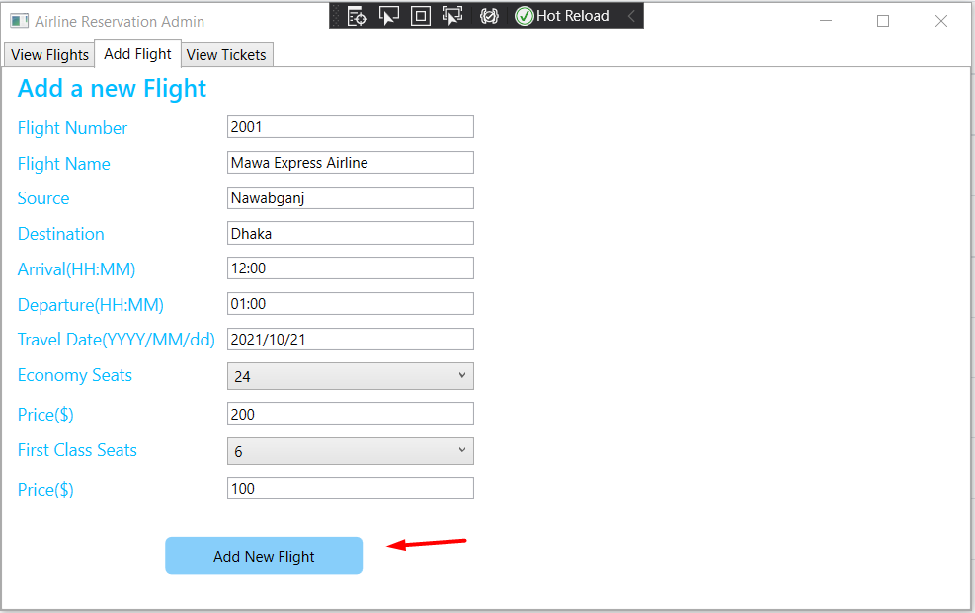
Admin Home page

Slide 7
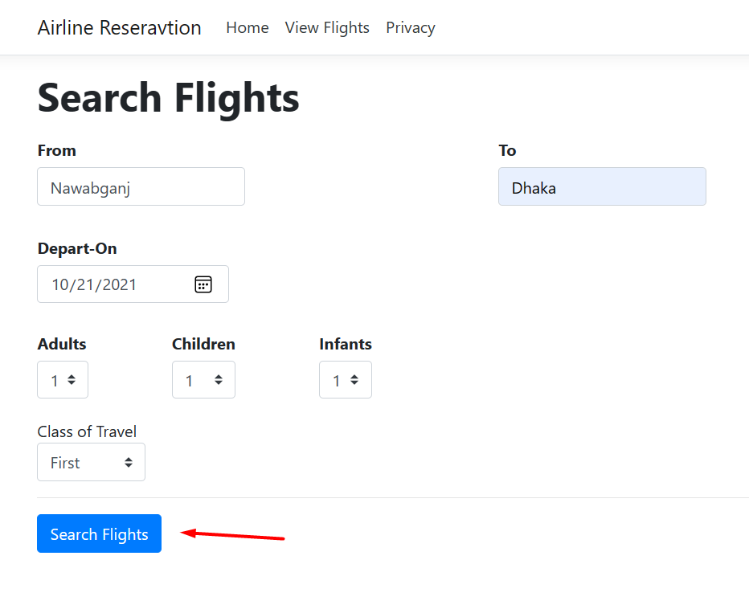
Users Home page or search flight page

Slide 8
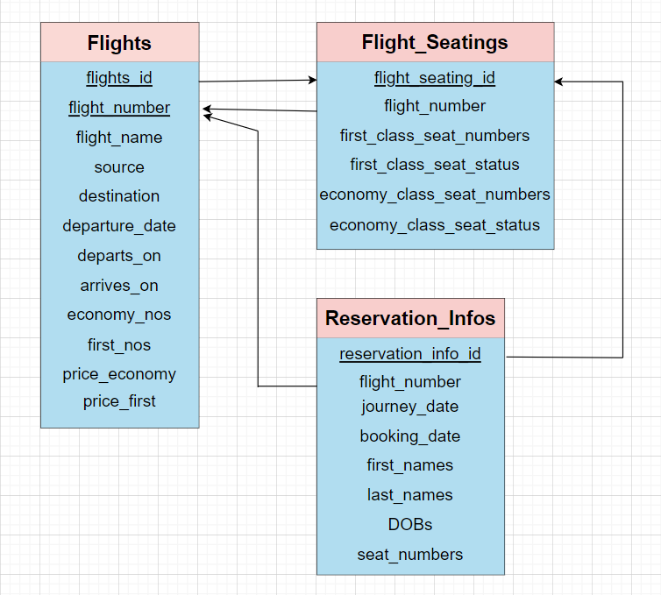
Schema

Slide 9
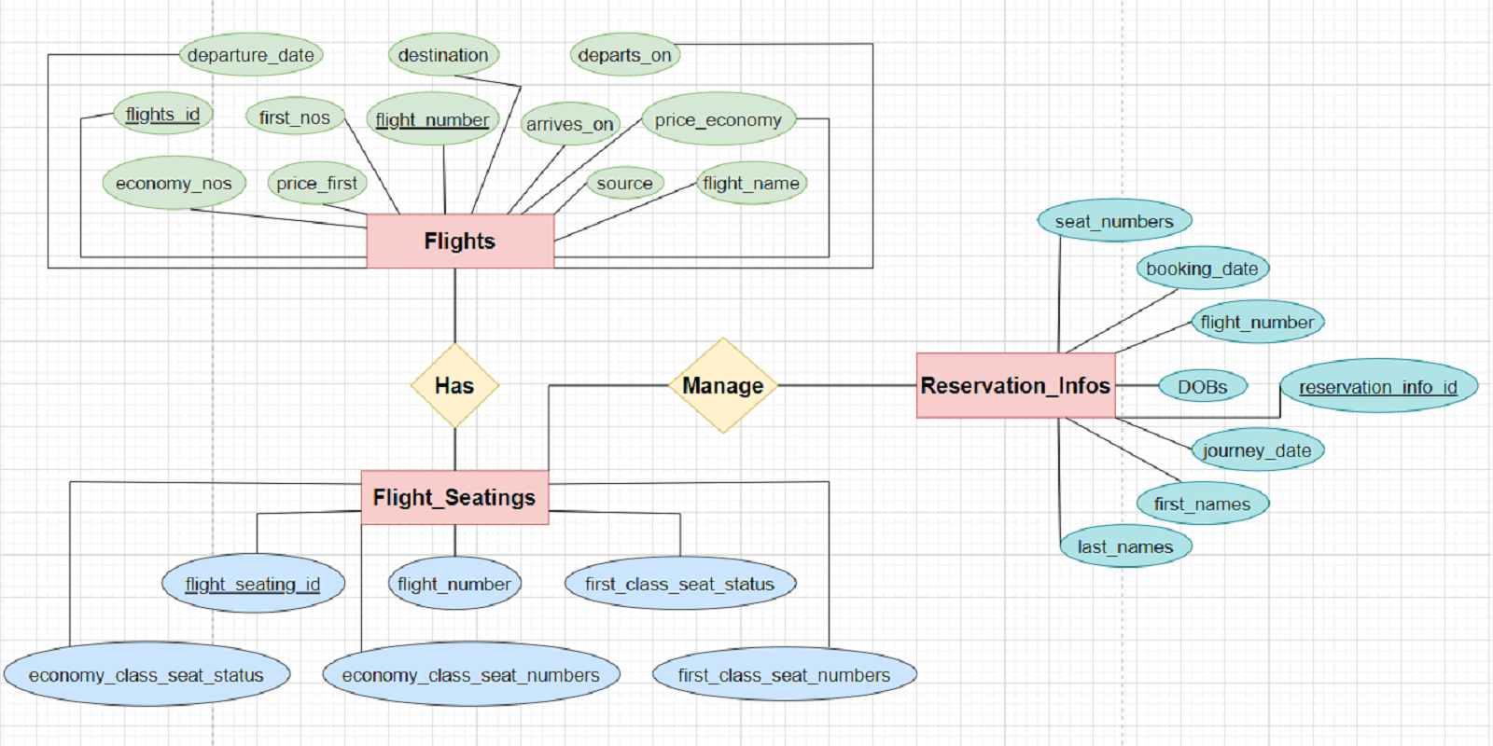
E-R diagram

Slide 10
Limitation of Work Plane
We have already taken many plans for the future work of our project.
If we want to keep our service quality accurate and equal for a long time, we must have a long-term plan, and that is what we have done. As we keep in mind the convenience of our passengers, the features need to be updated regularly.

Slide 11
Conclusion
Airline reservation systems incorporate airline schedules, fare tariffs, passenger reservations and ticket records.

Slide 12
Run code

Slide 13
THANK YOU

